Slide 1

Team Members
Harshdeep Singh
Anmolpreet Singh
Arun Bawa
4548158
4552878
4546955
“elevate your fitness journey.”

Slide 2
Agenda
Introduction to Jira
Reporting and Dashboards
Key Features of Jira
Integration with Other Tools
Workflow
Best Practices
Creating and Managing Issues
Case Studies
Assigning and Tracking Work
Conclusion

Slide 3

Agenda
Introduction to Jira
Key Features of Jira
Workflow
Reporting and Dashboards
Comprehensive Project Management & Issue Tracking
Versatile & Applicable Across Industries
Key Features of Jira
Integration with Other Tools
Workflow
Best Practices
Popular Among Agile Development Teams
Additional Integrations Capabilities
Creating and Managing Issues
Case Studies
Assigning and Tracking Work
Conclusion

Slide 4





Introduction to Jira
Key Features of Jira
Workflow
Issue Tracking
Project Management
Customizable Workflow
Integration With Other Tools
Collaboration & Communication Tools

Slide 5
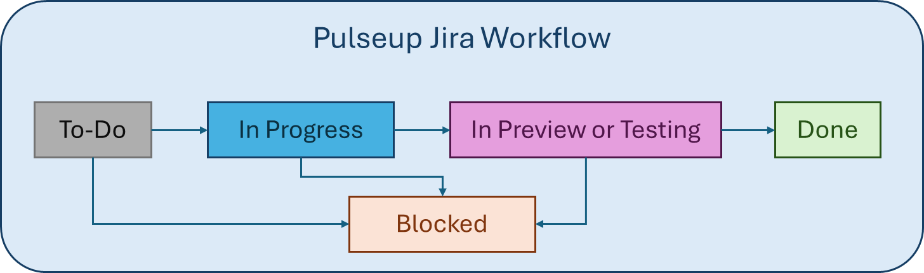
Introduction to Jira
Key Features of Jira
Workflow
Creating and Managing Issues
Importance
Efficiency
Clarity
Consistency

Slide 6





Introduction to Jira
Key Features of Jira
Workflow
Creating and Managing Issues
Identification | Creation in Jira | Assigning Sprint | Board Prioritization
New Feature
Issue Type
Bug
Title
Task
Description
Sprint
To-Do
Goal
Assignee
Parent
Improvement

Slide 7
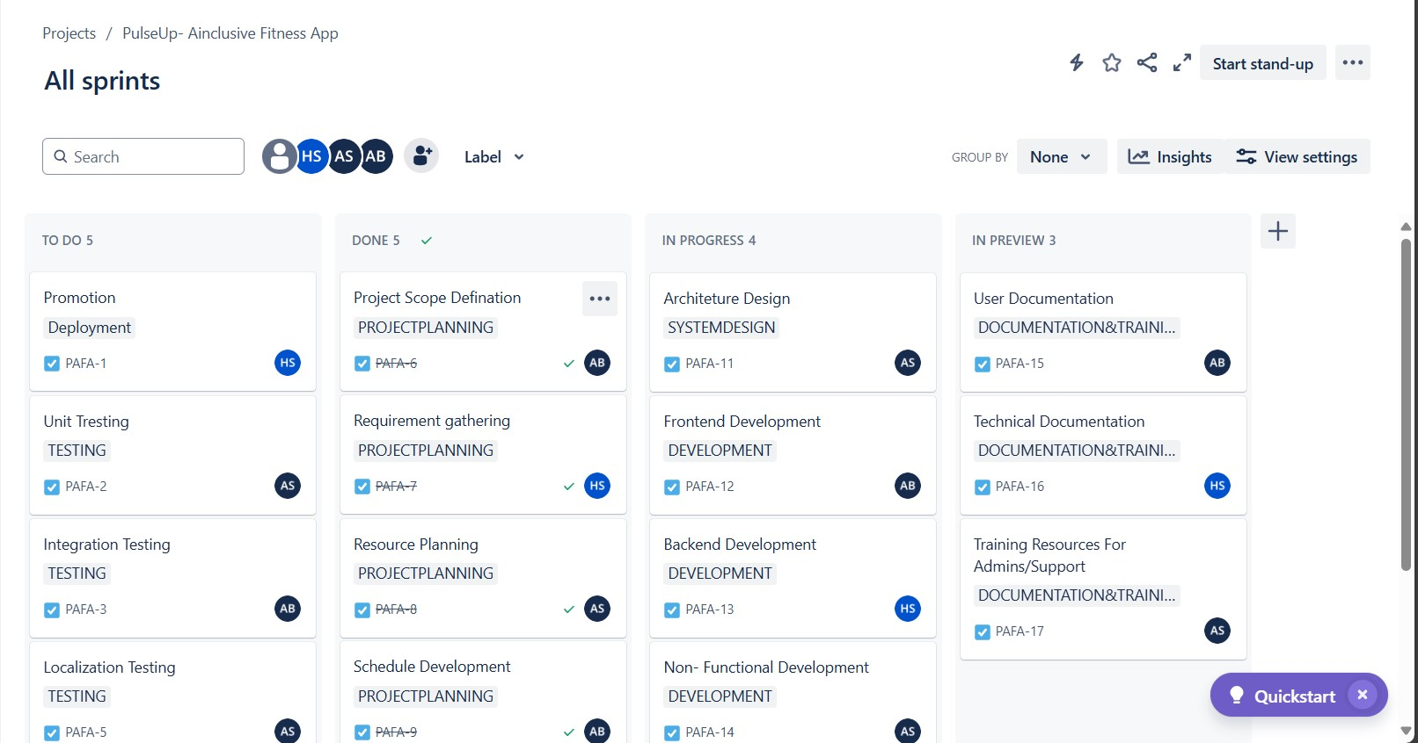
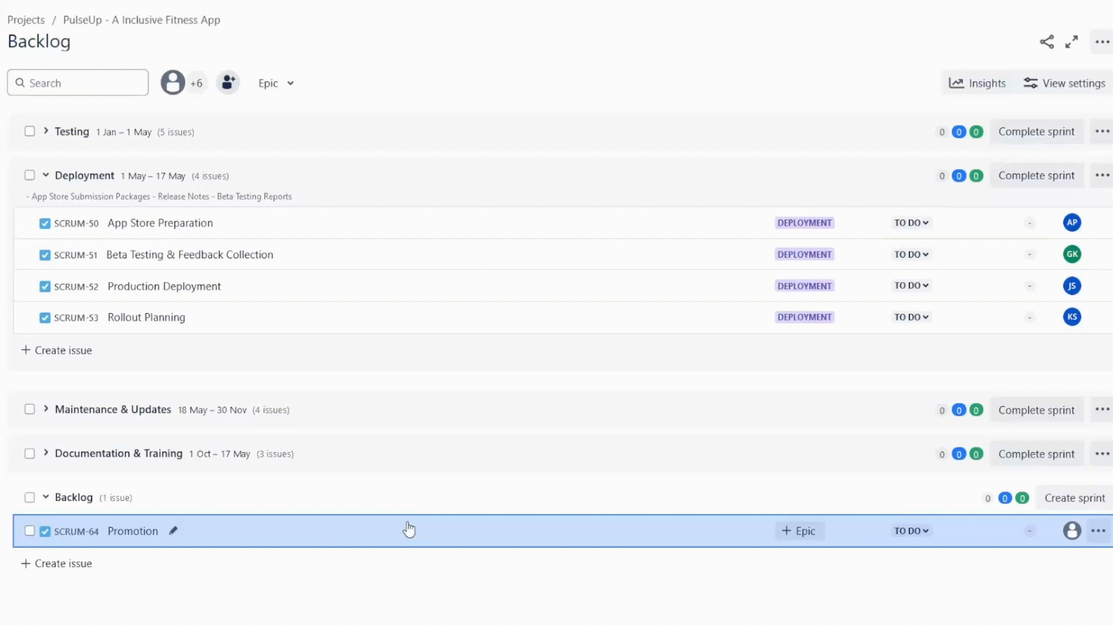
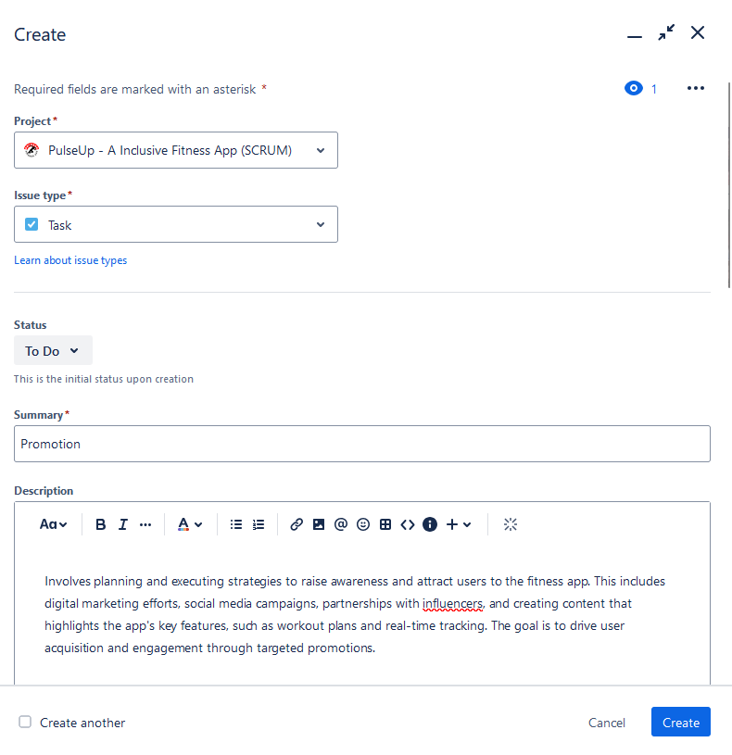
Creating and Managing Issues
Introduction to Jira
Key Features of Jira
Workflow
Issue Creation Example
Description of Issue
Board Prioritization
Assigning Sprint

Slide 8
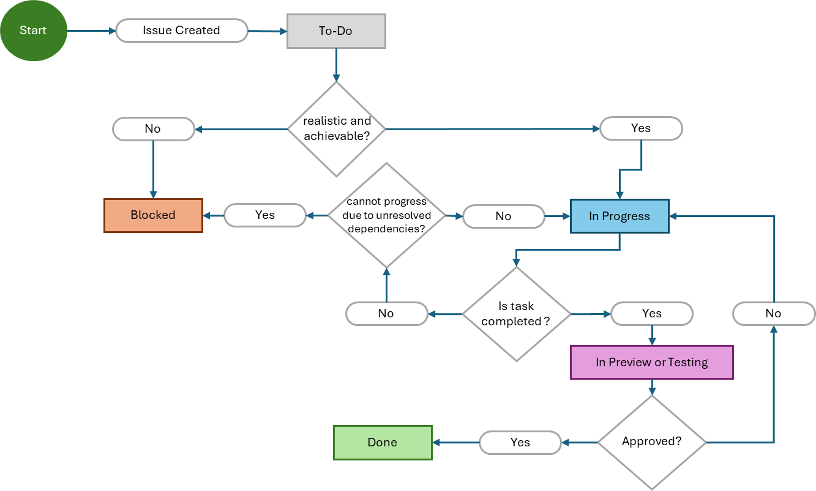
Introduction to Jira
Key Features of Jira
Workflow
Creating and Managing Issues
Assigning and Tracking Work
Task Issue Lifecycle Flowchart

Slide 9
Introduction to Jira
Key Features of Jira
Workflow
Creating and Managing Issues
Assigning and Tracking Work
Reporting and Dashboards
Work Assignment
Issues
Sprints
Epics
Assignee
Tracking and Monitoring
Scrum Boards
Timeline
Issue Status
Epic List

Slide 10
Introduction to Jira
Key Features of Jira
Assigning and Tracking Work
Workflow
Creating and Managing Issues
Reporting and Dashboards
Real Time Insight
Key Performance Indicator (KPI)
Trend Analysis
Bottleneck Detection
Customizable Dashboard

Slide 11
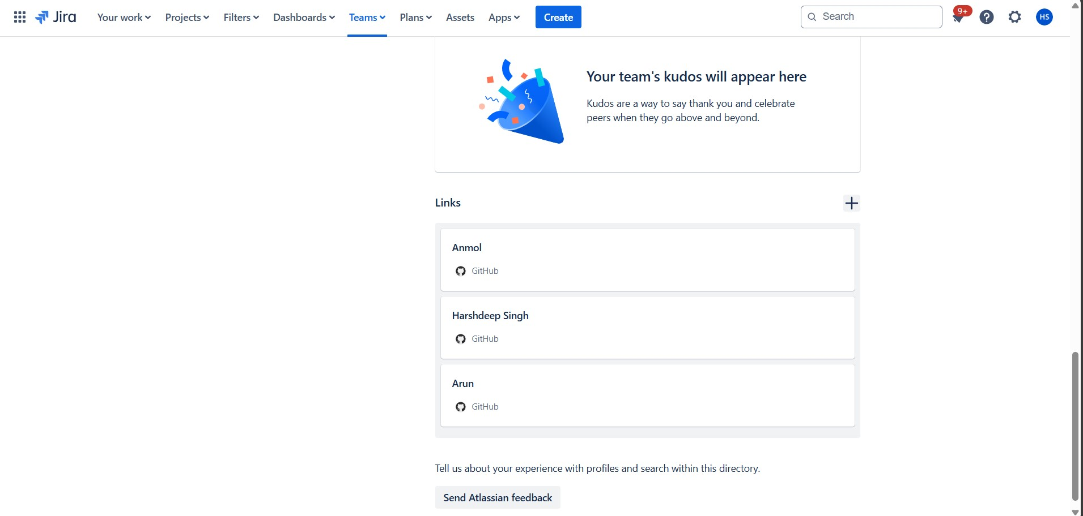
Introduction to Jira
Reporting and Dashboards
Key Features of Jira
Assigning and Tracking Work
Workflow
Creating and Managing Issues
Integration with Other Tools
Best Practices
Confluence
Slack
Trello

Slide 12
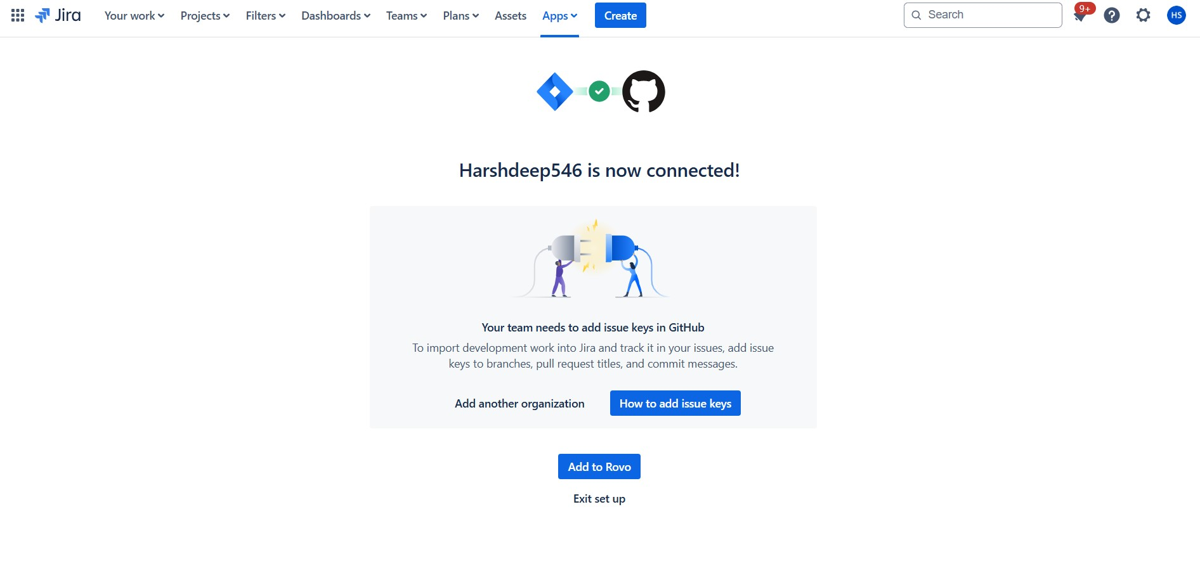
Introduction to Jira
Reporting and Dashboards
Key Features of Jira
Assigning and Tracking Work
Workflow
Creating and Managing Issues
Integration with Other Tools
Best Practices
Confluence
Slack
Trello

Slide 13
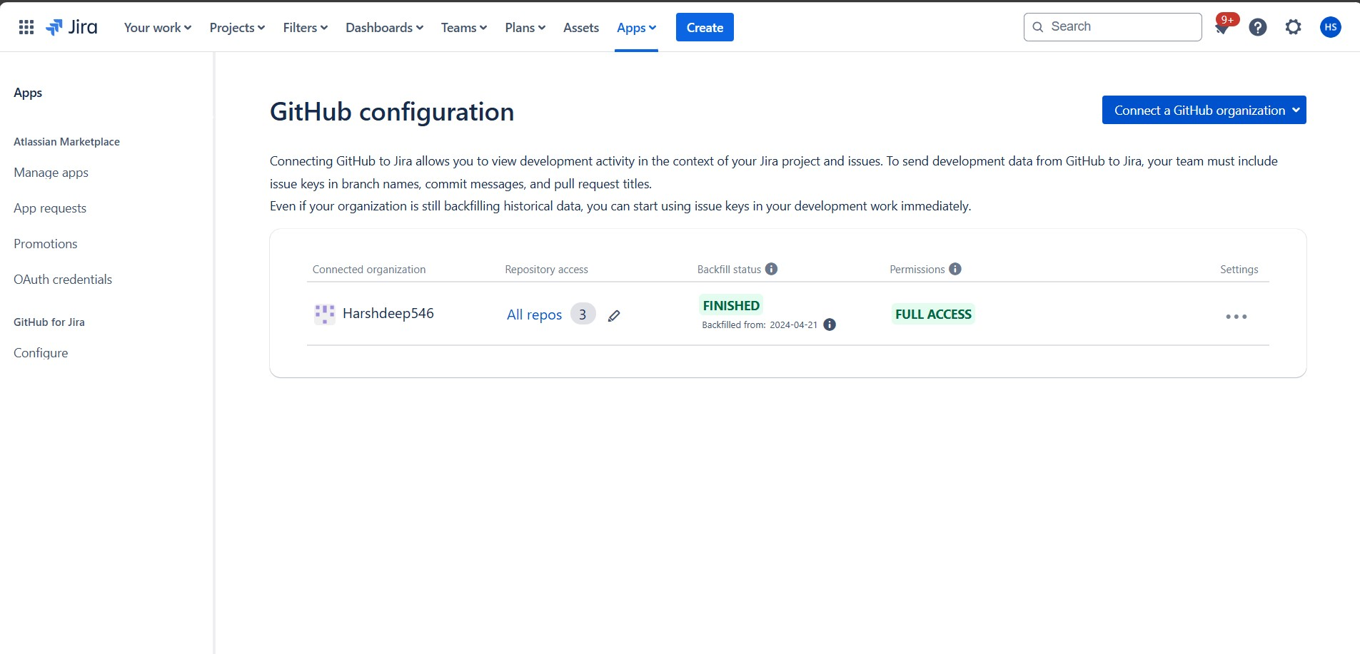
Introduction to Jira
Reporting and Dashboards
Key Features of Jira
Assigning and Tracking Work
Workflow
Creating and Managing Issues
Integration with Other Tools
Best Practices
Confluence
Slack
Trello

Slide 14
Introduction to Jira
Reporting and Dashboards
Key Features of Jira
Integration with Other Tools
Assigning and Tracking Work
Workflow
Creating and Managing Issues
Best Practices
Case Study
Consistent Issue Naming/Labeling
Dashboards for Visual Progress
Regular Updates and Communication
Frequent Status Updates
Custom Jira Settings to Match Team Preferences

Slide 15


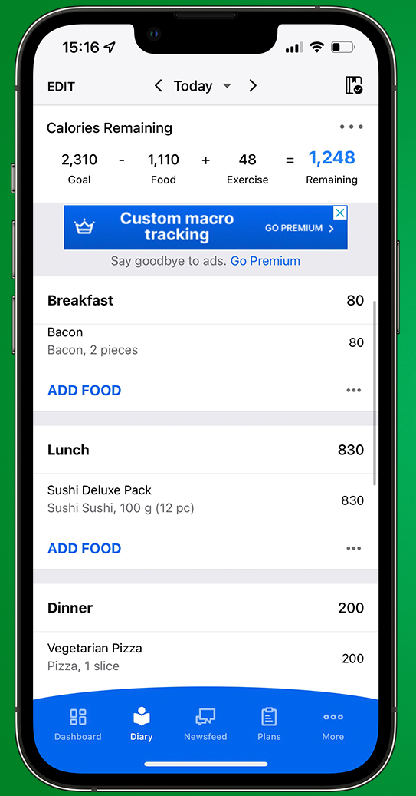
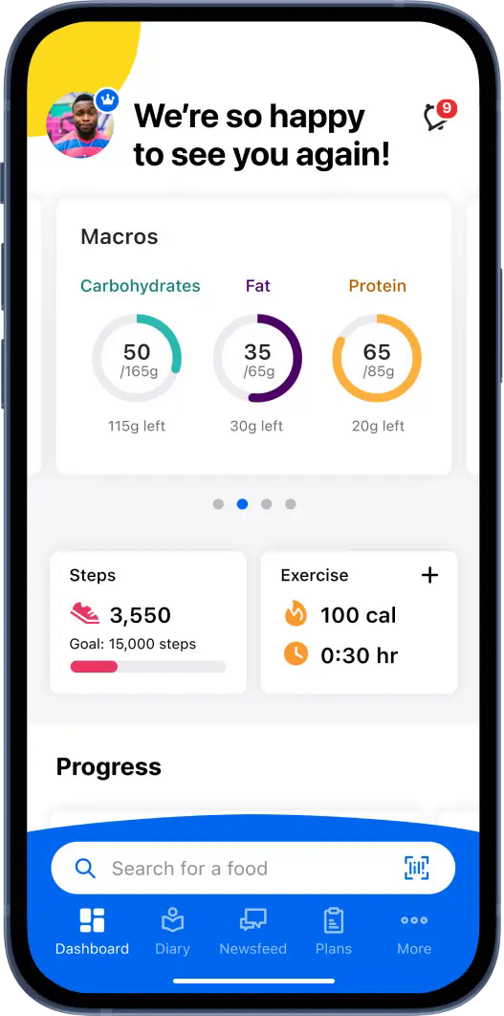
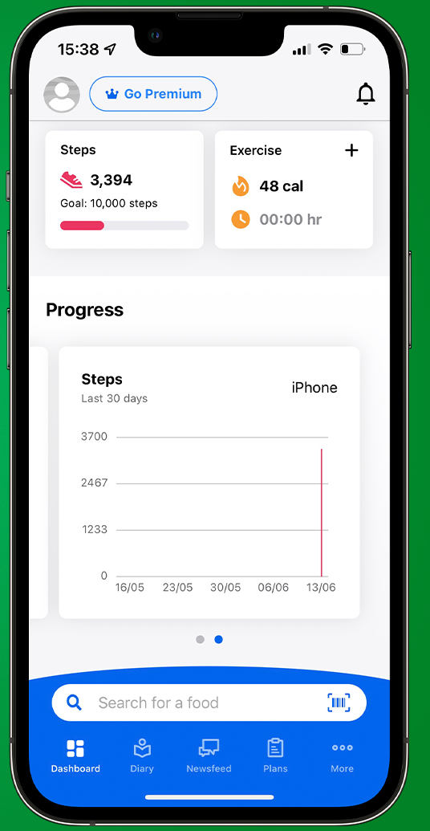
Best Practices
Introduction to Jira
Reporting and Dashboards
Key Features of Jira
Assigning and Tracking Work
Workflow
Creating and Managing Issues
Case Study
MyFitnessPal is a popular health and fitness platform that provides tools for tracking diet, exercise, and overall wellness. Their web-based app allows users to log their meals, track their workouts, and monitor their progress towards health goals.

Slide 16
Introduction to Jira
Reporting and Dashboards
Key Features of Jira
Assigning and Tracking Work
Workflow
Creating and Managing Issues
Case Study
Conclusion
Analysis
Challenges
Why Jira?
Results
Agile Project Management
User Engagement
Improved Efficiency
Cross
-
Functional
Collaboration
Remarkable Issue Tracking
Resolution
Data Integration
Enhanced Collaboration
Performance Metrics and
Reporting
Scalability
Quality Assurance
Better Resource Management
User Feedback Integration

Slide 17
Introduction to Jira
Reporting and Dashboards
Key Features of Jira
Assigning and Tracking Work
Workflow
Creating and Managing Issues
Case Study
Conclusion
Additional Resources
Topics Discussed
Jira and its Key Features
Workflow
Creating and Managing Issues
Assigning and Tracking Work
Reporting and Dashboards
Integration with Other Tools
Best Practices and Cases Studies

Slide 18
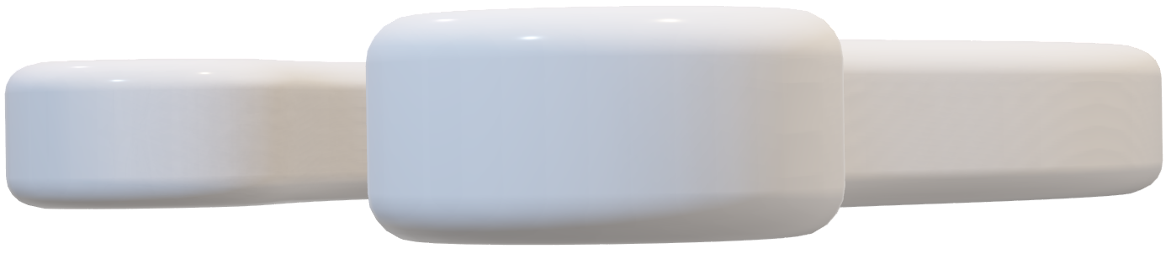
Introduction to Jira
Key Features of Jira
Assigning and Tracking Work
Workflow
Conclusion
Creating and Managing Issues
Additional Resources

Slide 19

Introduction to Jira
Reporting and Dashboards
Key Features of Jira
Assigning and Tracking Work
Workflow
Creating and Managing Issues
Q&A

Slide 20
Thank You

Slide 21
References
Ariz, A. (n.d.). MyFitnessPal Case Study. https://www.ashleyariz.com/work/myfitnesspal-casestudy
Choe, R. (n.d.). Case Study – MyFitnessPal. Rachel Choe.
https://www.rachelchoezhien.com/portfolio/case-study-myfitnesspal/
MyFitnessPal: A UX Case Study. (2017, March 23). Dreamrux.
https://www.dreamerux.com/articles/6n85nzx7kpyxdj3wj6elmrer83nsmj

